Slide 1
Crypto for Underserved Populations: A Data-Driven Approach
Brendan Byrnes, Griffin Lester, Vish Nalagatla
Notes:
Griffin

Slide 2



Meet the Team
Brendan Byrnes
Chagrin Falls, OH
MSBA ‘22
Griffin Lester
Saint Louis, MO
MSBA ‘22
Vish Nalagatla
Mason, OH
MSBA ‘22
Notes:
Griffin

Slide 3

Agenda
Problem Definition
Data Preparation and Modeling
Our Chatbot Solution
Business Value
Limitations
Moving Forward
Notes:
Griffin

Slide 4
Problem Definition
Notes:
Griffin

Slide 5

Current State of Cryptocurrency
Cryptocurrency: a form of virtual currency that is decentralized and secured by cryptography
Over 18,000 cryptocurrencies in existence in 2022
Current market cap of around $1.7 trillion
Over $91 billion in cryptos are traded every day
Source: weforum.org

Slide 6



Our Audience: Underserved Populations
Why are Black, Asian American, Latinx, and other underbanked communities in America beginning to invest in cryptocurrency?
Easy Access
Popularity
Freedom

Slide 7

Project Goal: Simplify Crypto for these Populations
Provide educational resources.
Build a simple crypto tool.
Provide simple recommendations about when to invest in which crypto.
NOTE: We are not financial advisors. Our recommendations should not be interpreted as explicit financial advice.

Slide 8
Data Preparation and Modeling

Slide 9

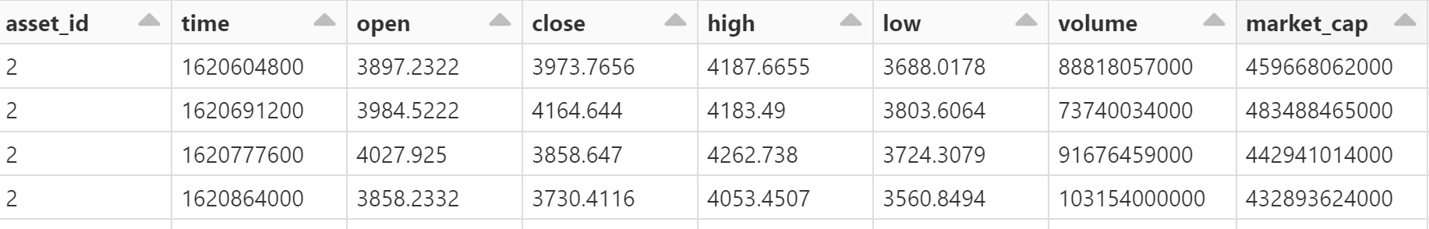
Obtaining Data
Lunar Crush API (Free)
Allows us to pull data for any cryptocurrency
Has to be transformed
Ethereum Below
ETH, BTC, ADA, DOGE, LTC

Slide 10

Rolling Mean
A column that calculates the average for a previous number of days
Each new day, the average will change based on the new window
Longer Window = Less Extreme Changes
7 Day/50 day

Slide 11
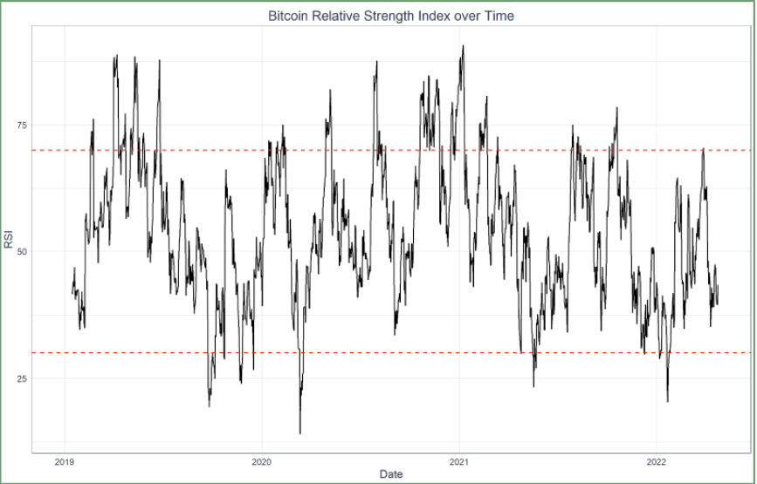
RSI (Relative Strength Index)
Often used for financial evaluation (0-100)
Uses the average gain/average loss for a period of time
Below 30
Investment is underbought (time to buy)
Above 70
Investment is overbought (time to sell)

Slide 12


Galaxy Score
Proprietary Measure of Lunar Crush
Essentially the average of 4 scores
Price Score - Uses market value/moving average to indicate upward/downward trends
Social Impact Score - Evaluates size of market/awareness of a coin
Correlation Rank - Correlation between social data and price/volume
Average Sentiment Score - Score of bullishness or bearishness depending on social media

Slide 13

Auto ML
Utilized dataset to forecast RSI and Galaxy Score per coin
Used a 7-day forecast because cryptocurrencies can be very volatile
Prophet Model (Facebook product)
Forecasting model - Additive
Takes into account seasonality as well

Slide 14

Model Error Metrics
Relative Strength Index (RSI)
val_mae | val_mse | val_rmse
4.736 | 32.68 | 5.14
Galaxy Score
val_mae | val_mse | val_rmse
1.401674 | 3.366519 | 1.557195

Slide 15
Our Chatbot Solution

Slide 16
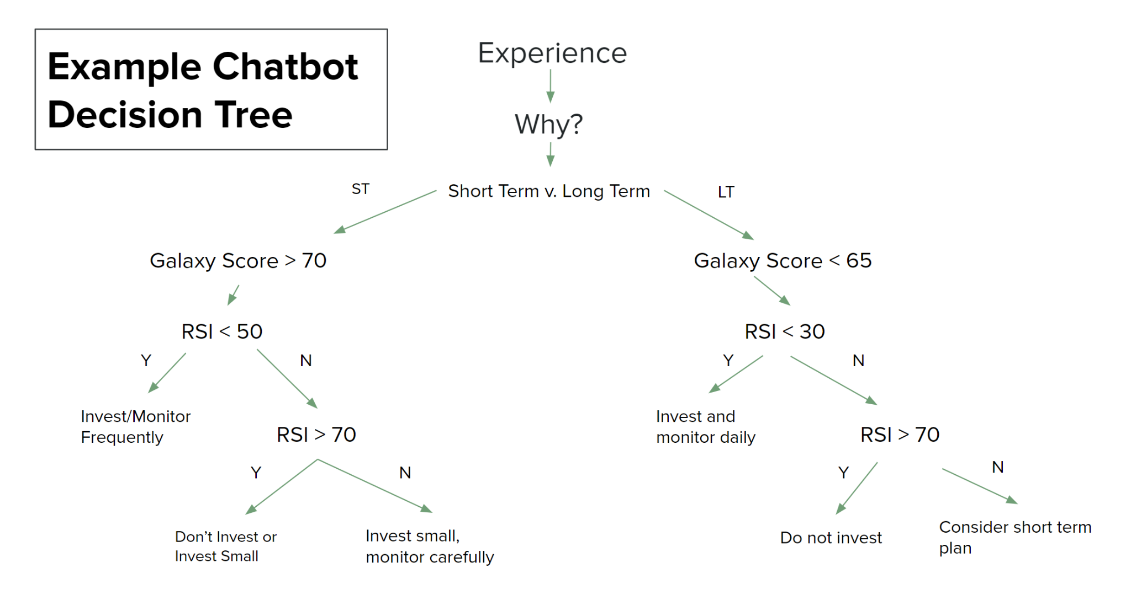
<

Slide 17


Chatbot Demo
Automated responses to user input
Currently hard-coded

Slide 18
Business Value

Slide 19
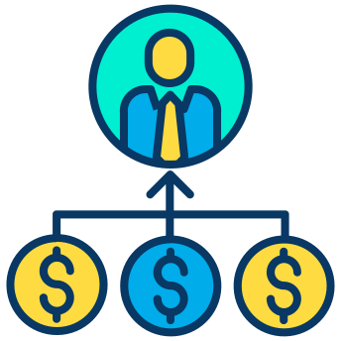
Business Value
Created a data-driven approach that is accessible to all
A fully-functioning, version 2.0 chatbot will be able to pull from our databricks workflow or from our dataset, using a lambda function, to automatically use the resulting values to recommend a certain coin

Slide 20
Limitations

Slide 21

Limitations
Hard coded chatbot
Cryptocurrencies may not follow traditional investment strategies
Does not incorporate social network calls to buy or sell certain assets (e.g. meme stocks)

Slide 22
Moving Forward

Slide 23
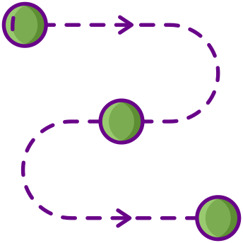
Next Steps
Create version 2.0 of the chatbot that incorporates our databricks workflow and/or data in a lambda function
Create a streaming instance for data gathering
Publish chatbot to a website or some other platform

Slide 24
Thank You
Are there any questions?

